Slide 1
DLOR REPORT

Slide 2
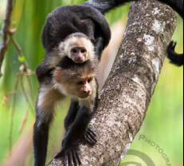
Introduction
I chose the 10 Monkey Species dataset as classifying monkey species is helpful in identifying endangered species of monkeys, which helps wildlife rangers in their preservation efforts.

Slide 3
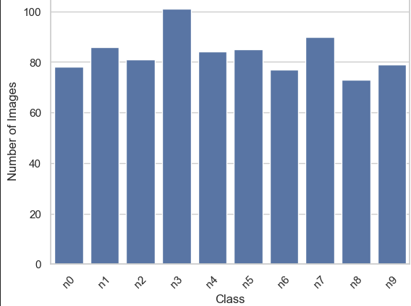
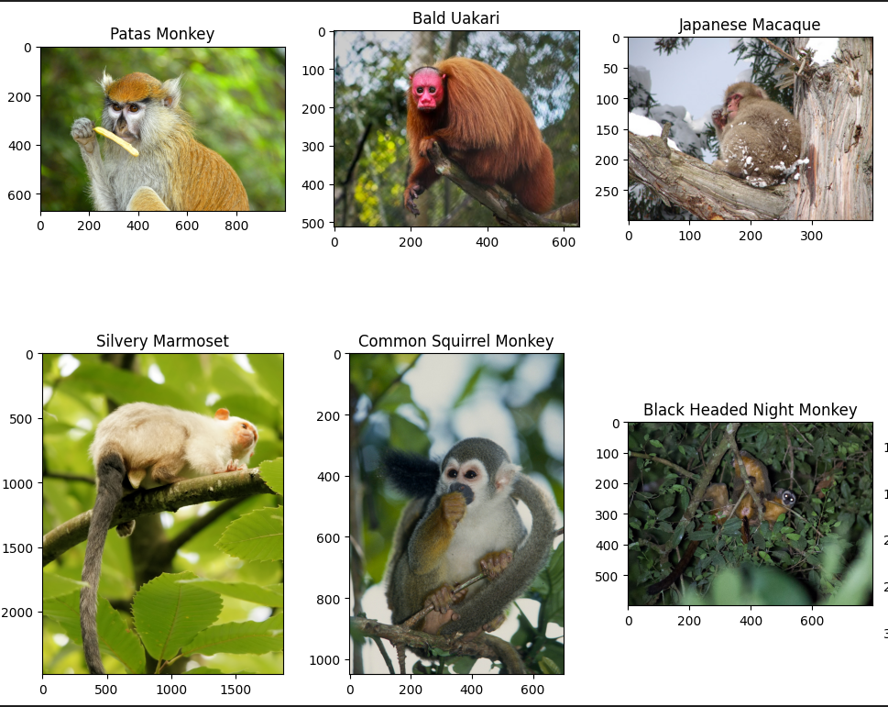
Exploratory Data Analysis
Classes are quite balanced;
No under-/over-sampling needed
Classes are all visually distinct

Slide 4
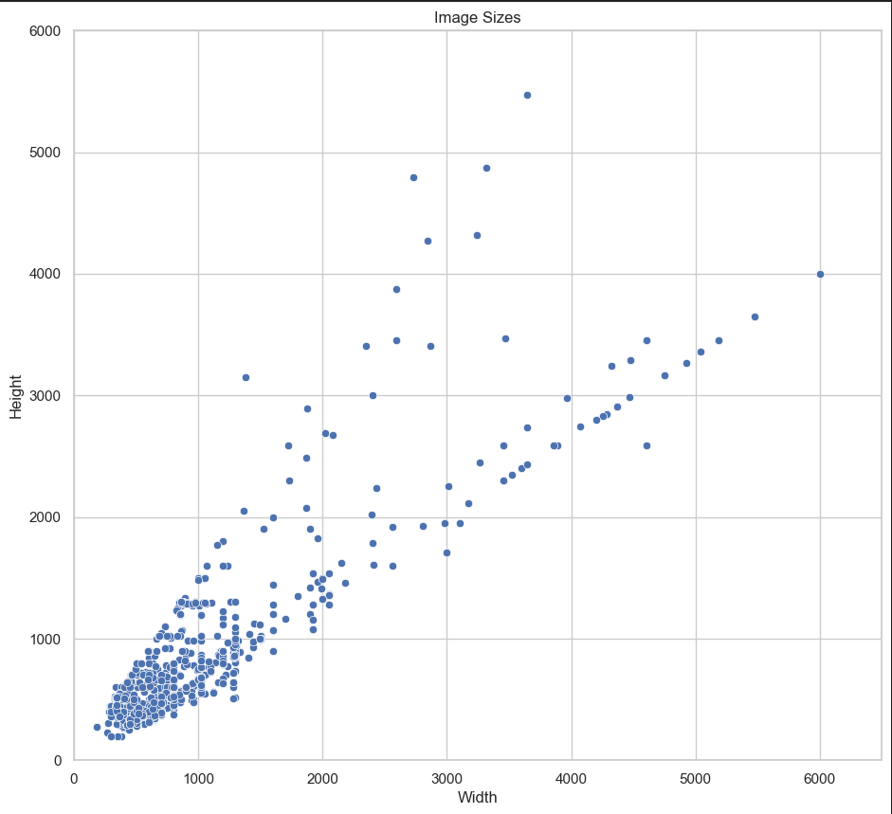
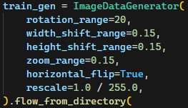
Data Preprocessing
Images are roughly square in shape, and won’t be distorted much upon resizing
Pixel values were normalised to the range [0, 1] for numerical stability
Moderate data augmentation was applied to help with generalisation

Slide 5
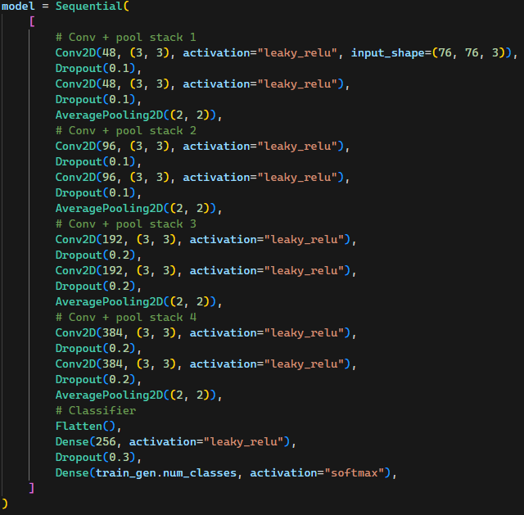
Baseline Model
A vanilla CNN was trained from scratch to act as a baseline
Leaky ReLU was used to avoid the vanishing gradient problem
A small image size was used to speed up training
Due to the small input size, average pooling is better suited as it preserves more information
2 convolutional layers were put between each pooling layer to increase learning capacity while maintaining a small input size

Slide 6
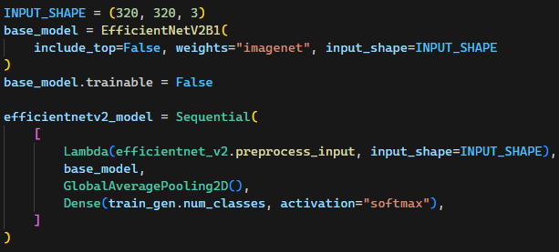
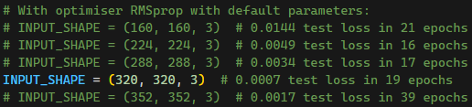
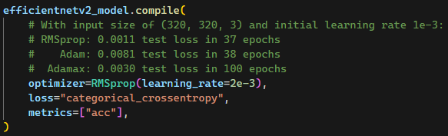
Additional Models
Due to the distinctiveness of each class and small size of the dataset (~1200 images), most of the pre-trained models were able to achieve perfect accuracy with a 1-layer classifier
Hypertuning was focused on the input shapes and optimisers
The best models perform over 1000x better* than the baseline while having as little as 2.5x the number of parameters!
*Calculated by taking the ratios between their test losses

Slide 7
Evalutaion And Analysis
Test accuracy is shown here as it is an intuitive measure of performance that is easy to interpret
Multiple models achieved 100% accuracy, so loss is needed as a more precise measure
Model | Accuracy (%) | Loss
Vanilla CNN (Baseline) | 81.9 | 0.8351
InceptionV3 | 98.6 | 0.0238
Xception | 99.3 | 0.0303
EfficientNetB2 | 100.0 (!) | 0.0005
EfficientNetV2B1 | 100.0 (!) | 0.0007
ResNet50V2 | 100.0 (!) | 0.0055
EfficientNetV2B1 Small | 100.0 (!) | 0.0011

Slide 8
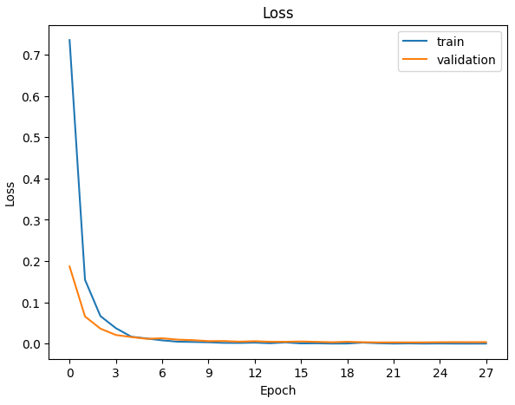
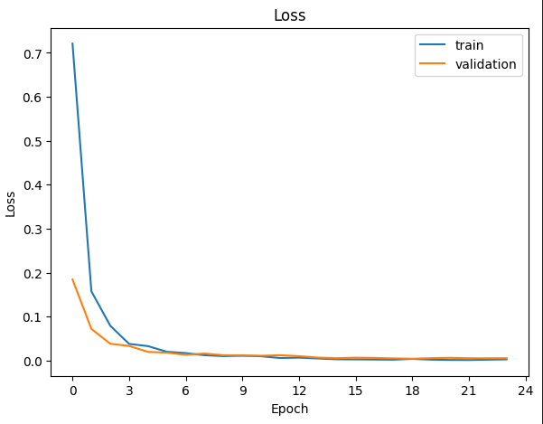
Evalutaion And Analysis
Learning curves show that the 2 best models (EfficientNetB2 and EfficientNetV2B1) are not overfitted despite the absurdly low losses

Slide 9
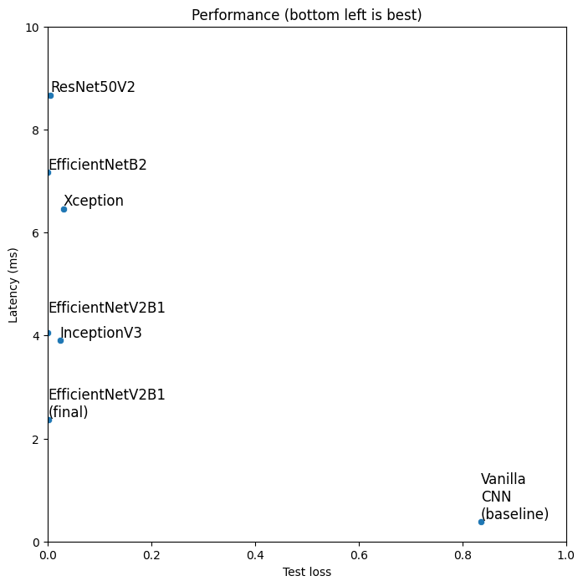
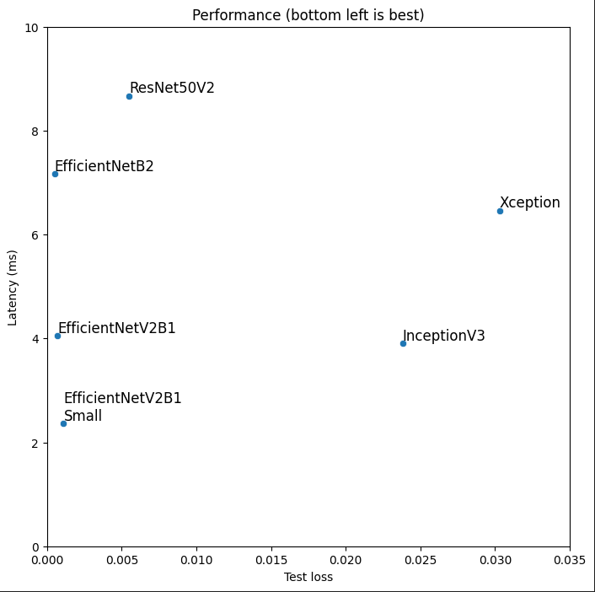
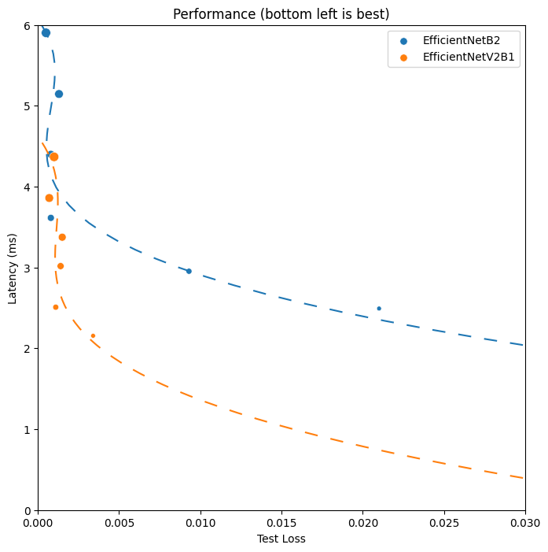
Model Optimisation
Inference latency is another important factor to consider when deploying to mobile where computing resources are limited
EfficientNet models were originally trained on progressively larger images and generalise well to different image sizes
Model | Input Size | Latency* (ms) | Loss
V1 (256x256) | 256x256 | 3.61 | 0.0025
V1 (352x352) | 256x256 | 3.61 | 0.0008
V1 (352x352) | 352x352 | 5.90 | 0.0005
V2 (224x224) | 224x224 | 2.51 | 0.0049
V2 (320x320) | 224x224 | 2.51 | 0.0011
V2 (320x320) | 320x320 | 3.86 | 0.0007
*Latency was measured using the best of 3 consecutive runs on 1000 batched images on the GPU. This minimises error due to cold cache and overhead from copying memory to the GPU.

Slide 10
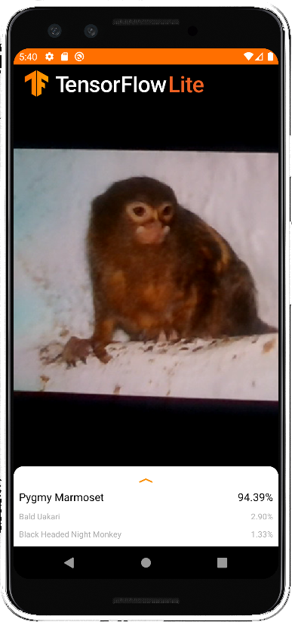
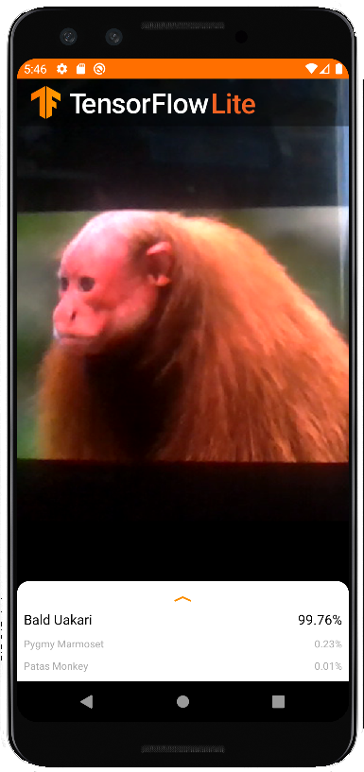
Android Deployment
Model continues to perform well after deployment
“Freeze” feature added to freeze camera and predictions
✅Pygmy Marmoset – 94.39%
✅Bald Uakari – 99.76%

Slide 11
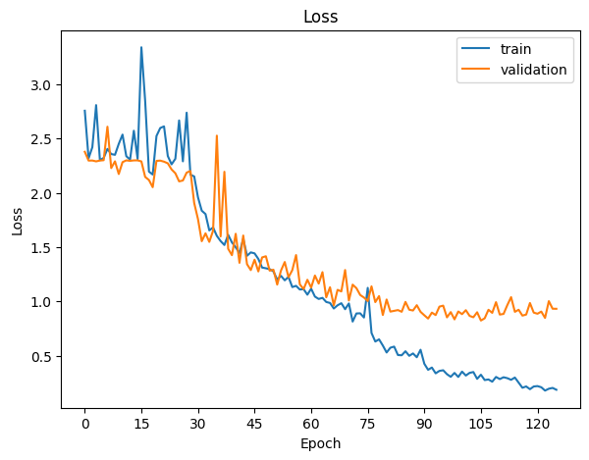
Conclusion
What went wrong?
Future Improvements
The small size of the dataset presented the greatest challenge in training a high-performance model from scratch, as it led to overfitting despite preventive measures like copious amounts of dropout. This resulted in a large reliance on pre-trained models.
External data similar to the current dataset can be sourced and used to increase the amount of data available for training. Established architectures like EfficientNets can also be trained from scratch instead of using transfer learning.
Notes:
However, the pre-trained models were trained without any knowledge of the monkey classification problem, leaving room for further optimisation.

Slide 12
References
EfficientNet (inspiration for changing input size): https://arxiv.org/abs/1905.11946
The All Convolutional Net (ideas for custom CNN): https://arxiv.org/abs/1412.6806
Keras Applications documentation (info about pre-trained models): https://keras.io/api/applications/

